Slide 1
GRAM NEGATIVE BACTEREMIA AND SEPSIS
PRESENTERS
NADHIRU NASSOR RAMADHANI
ZAZI SIGONDA
FACILITOR
PROF.SHAYO

Slide 2
OBJECTIVES
Explain why is it important to study gram negative than gram positive
Able to definition of bacteremia and sepsis septic shock
Able to explain the pathophysiology of sepsis and finally septic shock
How patient presents in both sepsis and septic shock
Management available guideline ( standard treatment guidelines and international studies )
  What international study says
Able to know key findings of new SURVIVING SEPSIS CAMPAIGN2026 as compared to SSC of 2016

Slide 3
OUTLINE
Introduction
Epidemiology
Risk Factors and Aetiology
Overview on clinically important gram negatives and MRSA
Pathophysiology of sepsis
Clinical presentation
Approach to a patient with Septicaemia
Management
Complications

Slide 4
INTRODUCTION
Bacteremia: Presence of bacteria in the bloodstream; can progress to severe infection.
Sepsis: Life-threatening organ dysfunction caused by a dysregulated response to infection. Organ dysfunction begins (e.g., AKI, altered mental status, hypoxia)
Septic shock: Severe sepsis with circulatory failure requiring vasopressors to maintain MAP ≥65 mmHg and persistent serum lactate >2 mmol/L despite adequate fluid resuscitation, associated with high mortality
Global impact: ~ 49 million cases and 13 million sepsis-related deaths each year (2030 Global Agenda for Sepsis: Making the next Success Story in Global Health, n.d.) , recognized as a priority by the World Health Organization.

Slide 5
SIGNIFICANCY OF GRAM-NEGATIVE BACTERIAL OVER GRAM-POSITIVE BACTEREMIA
Shift in Pathogens: Increasing cases of bacteremia are now caused by Gram-negative bacteria; Escherichia coli has surpassed Staphylococcus aureus as the most common bloodstream pathogen, followed by Klebsiella pneumoniae and Pseudomonas aeruginosa. (Holmes et al., 2021)
In study done by silango et al found that sepsis at bugando neonatal ward had the prevalence of culture confirmed bacteremia of 34.5% of which 85.5% were GNB (Silago et al., 2020)
  Article done by Holmes, C. L., Anderson, M. T., Mobley, H. L. T., & Bachman, M. A. (2021). Pathogenesis of Gram-Negative Bacteremia. https://doi.org/10.1128/CMR

Slide 6
CONT…
Bacteremia due to gram negative bacilli(E.coli, klebsiella and pseudomonas etc. ) has
  higher proportion of community-onset than hospital-onset bacteremia
  poses a serious therapeutic difficulties because of increasing incidence in multidrug resistance
Gram negative bacillary sepsis with shock has a mortality rate of 12-38%

Slide 7
CONT…
a large international ICU study on infection, microbiology, antibiotic use, and mortality done by Vincent et al found that
High burden of ICU infections: 54% of 15,202 ICU patients had suspected/confirmed infection, with ICU-acquired infections linked to higher mortality (OR 1.32).
Microbiology & antibiotic resistance: Gram-negative bacteria were most common (67%), and 65% had positive cultures; resistant organisms (e.g., vancomycin-resistant Enterococcus, carbapenem-resistant Acinetobacter) were strongly associated with increased death risk.
Clinical outcomes: In-hospital mortality among infected patients was high (30%), with 70% receiving antibiotics, highlighting the severity and treatment burden of ICU infections globally. (Vincent et al., 2020)

Slide 8
MULTI DRUG RESISITANCE …
MDR pathogens: Bacteria with resistance to ≥1 drug in ≥3 antimicrobial classes
Examples:
  Acinetobacter baumannii,
  ESBL-producing Gram-negative bacteria,(E coli,Klebsiella spp Pseudomonas sp)
  Carbapenem Resistance Enterococci,
  Vancomycin Resistant Enterococci,
  multidrug-resistant Pseudomonas aeruginosa,
  MRSA
Significance: They Cause difficult-to-treat infections and require careful antibiotic management(de Oliveira & de Castro, 2025)
Most of them are gram negative bacteria

Slide 9
RISK FACTORS FOR MDR PATHOGENS INCLUDE,
previous infection with the MDR pathogen of concern,
colonization with the mdr pathogen of concern
prolonged use of broad‑spectrum antibiotics, and
prolonged hospitalization in a unit with a high prevalence of the MDR pathogen of concern
Genetic factor
Intensive care unit hospitalization
Invasive procedures
Comorbidities (e.g. malignancies, chronic liver disease and chronic kidney disease)
Advanced age
Immunosuppression
Previous hospitalization

Slide 10
ETIOLOGY OF GRAM NEGATIVE BACTERMIA
Frequency of specific gram-negative bacteremia differs by either the infection is hospital or community acquired, and by the likely primary source of infection
Hospital acquired:
  E. coli, K. pneumoniae, P. aeruginosa, Proteus spp
ICU:
  P. aeruginosa, Enterobacter spp, K. pneumoniae
Community based:
  -E. coli, P. aeruginosa, K. pneumoniae, Salmonella spp

Slide 11
CLINICALLY IMPORTANT GRAM NEGATIVE AND (SOME) GRAM POSITIVE BACTERIA
Extended beta lactamase producers (EBSL)
  E coli
  Klebsiella spp
  Proteus spp
  Enterobacter
  Salmonella spp
  Pseudomonas spp
  MDR pathogens Acinetobacter baumannii, ESBL-producing Gram-negative bacteria, CRE, VRE, multidrug-resistant Pseudomonas aeruginosa, MRSA:
Some gram-positive bacteria (MRSA, enterococci)

Slide 12
MAJOR MULTIDRUG-RESISTANT GRAM-NEGATIVE PATHOGENS
Pseudomonas aeruginosa: Gram-negative aerobic bacillus; causes VAP, UTI, SSTI, endocarditis; forms biofilms on invasive devices; highly multidrug-resistant.
Klebsiella pneumoniae: Encapsulated Gram-negative bacillus causing severe necrotizing lobar pneumonia; associated with alcoholics/diabetics; ‘currant jelly sputum’.
Escherichia coli: Normal gut flora; leading cause of community and hospital-acquired UTI; major ESBL-producing pathogen.
Acinetobacter baumannii: MDR Gram-negative coccobacillus linked to healthcare settings; causes VAP, bloodstream infections, and UTI with high mortality.

Slide 13
EMPIRIC AND ESCALATION THERAPY IN SEVERE SEPSIS DUE TO
Immediate empiric therapy (within 1 hour): Ampicillin + Cloxacillin + Gentamicin for broad Gram-positive and Gram-negative coverage.
Reassess within 24 hours: If no improvement, escalate to Ceftriaxone + Gentamicin and refer for higher-level care.
Advanced therapy for severe/non-responding cases: Piperacillin-Tazobactam or Ceftriaxone-Sulbactam + Gentamicin.
Escalation for resistant organisms: Meropenem or Vancomycin based on culture results and specialist guidance.
Adjunct therapy: Add Metronidazole or Clindamycin for anaerobic coverage; reserve Colistin + Linezolid for MDR infections.

Slide 14
SEPSIS
Following the better understanding of the research, physiology, and management, Sepsis definitions were revised by the Third International Consensus Definitions for Sepsis and Septic Shock (Sepsis-3) (SSC 2016)
Sepsis is a life-threatening organ dysfunction caused by a dysregulated host response to infection.
It is clinically defined by Sequential [Sepsis-related] Organ Failure Assessment (SOFA) of more than 2 points (Predicts Mortality rate of 10%)
But a large cohort study (>221,000 patients) showed NEWS2 has the highest sensitivity and specificity for sepsis screening, and due to qSOFA’s poor sensitivity, guidelines recommend NEWS/NEWS2, MEWS, or SIRS over qSOFA as a standalone tool (Prescott et al.).
Notes:
Sensitivity and specificity are measures used to evaluate the accuracy of a medical test:
Sensitivity: The ability of a test to correctly identify people who have the disease (true positive rate).
→ High sensitivity means the test rarely misses the disease.
Specificity: The ability of a test to correctly identify people who do not have the disease (true negative rate).

Slide 15
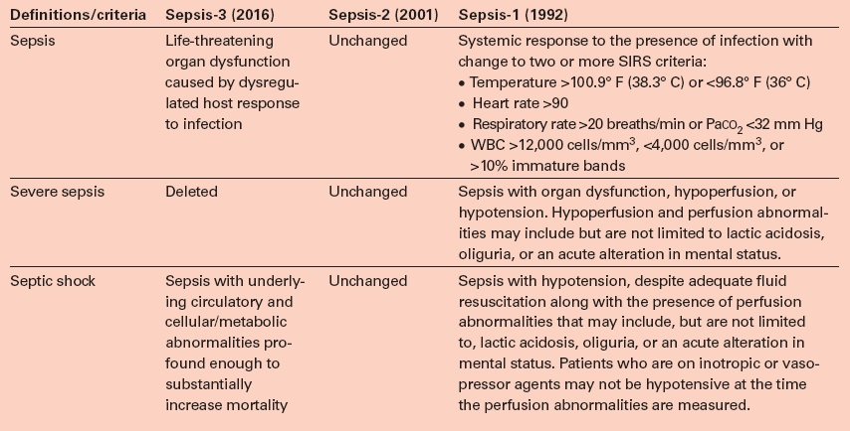

Slide 16
SEPTIC SHOCK
Septic shock: Severe sepsis with circulatory failure requiring vasopressors to maintain MAP ≥65 mmHg and persistent serum lactate >2 mmol/L despite adequate fluid resuscitation, associated with high mortality.
Epidemiology In 2020, sepsis affected ~48.9 million people and caused ~11 million deaths globally (~20% of all deaths), with about 85% of cases and deaths occurring in low- and middle-income countries.
A meta-analysis of 14 studies (2009–2022) in Sub-Saharan Africa found sepsis prevalence of 18% in East Africa and 20% in Southern Africa, with ICU prevalence of 14% and 13% respectively, indicating a consistently high burden with slight regional variation.
AS PER Surviving Sepsis Campaign: international guidelines for management of sepsis and septic shock 2026

Slide 17
RISK FACTOR FOR SEPSIS
Advanced age more than 65 years
Immunosuppression ( malignancies, AIDS, renal and hepatic failure and asplenism)
Previous hospitalization.
ICU admission, 50% of ICU admissions develop nosocomial infections.
Bacteremia, 95% of positive blood cultures were associated with sepsis and septic shock.

Slide 18
PATHOPHYSIOLOGY
LPS (endotoxin) from Gram-negative bacteria activates macrophages, triggering inflammatory cytokines (TNF, IL-1, IL-6, IL-8).
Cytokine storm causes systemic inflammation → fever, endothelial damage, coagulation problems (DIC), and widespread microvascular injury.
Results in septic shock → vasodilation, low blood pressure, tissue hypoxia, lactic acidosis, and possible multi-organ failure/death.
The evidence that sepsis results from an exaggerated systemic inflammatory response induced by infecting organisms is compelling. Inflammatory mediators are the key players in the pathogenesis of sepsis (see Table 3 below).

Slide 19
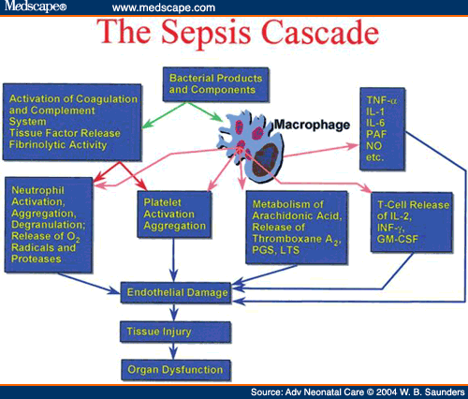
Notes:
The Sepsis Cascade refers to the series of pathophysiological events that follow a severe infection leading to systemic inflammation, organ dysfunction, and potentially death. It is triggered by an overwhelming host response to infection and involves immune, inflammatory, coagulation, and endothelial dysfunction pathways.
🧬 STEP-BY-STEP SEPSIS CASCADE:
1. Infection (Trigger)
Pathogen entry (bacteria, virus, fungus, parasite).
Common sources: lungs (pneumonia), urinary tract, abdomen, or bloodstream.
2. Pathogen Recognition by Immune System
PAMPs (Pathogen-Associated Molecular Patterns) on microbes are detected by:
PRRs (Pattern Recognition Receptors) like Toll-like receptors (TLRs) on macrophages, dendritic cells, and endothelial cells.
3. Activation of Inflammatory Pathways
Cytokine storm:
↑ Proinflammatory cytokines: TNF-α, IL-1, IL-6, IL-8.
↑ Anti-inflammatory cytokines: IL-10 (compensatory).
Neutrophils, monocytes, and complement system are activated.
Endothelial cells become activated → increased vascular permeability.
4. Endothelial Dysfunction
Loss of tight junctions → leaky capillaries.
Vasodilation → ↓ systemic vascular resistance.
Microvascular thrombosis → tissue hypoperfusion and organ ischemia.
Nitric oxide (NO) and prostaglandins contribute to vasodilation and hypotension.
5. Coagulation Abnormalities
Tissue factor expression is increased.
Disseminated Intravascular Coagulation (DIC) may occur:
↑ Microthrombi.
↓ Platelets and clotting factors → bleeding risk.
6. Cellular & Metabolic Dysfunction
Mitochondrial dysfunction → ↓ ATP → metabolic failure.
Lactic acidosis from anaerobic metabolism due to poor perfusion.
Apoptosis of immune and epithelial cells.
7. Organ Dysfunction (Severe Sepsis)
Lung: ARDS (acute respiratory distress syndrome).
Kidney: Acute kidney injury (AKI).
Liver: Cholestasis, failure.
Brain: Encephalopathy.
Heart: Myocardial depression.
8. Septic Shock
Persistent hypotension requiring vasopressors despite fluid resuscitation.
Serum lactate > 2 mmol/L = marker of tissue hypoxia.
9. Death (if unchecked)
Due to multi-organ failure (MOF), refractory hypotension, or irreversible cellular injury.
🔬 Summary Flowchart:
Infection → PRRs detect PAMPs → Cytokine storm → Endothelial damage + Vasodilation → Coagulation activation → Organ hypoperfusion → Organ dysfunction → Shock → Death
🎯 Key Mediators:
Pathway Mediators Inflammatory TNF-α, IL-1, IL-6 Endothelial NO, histamine, bradykinin Coagulation Tissue factor, thrombin, fibrin Metabolic Lactic acid, mitochondrial ROS 🧠 Mnemonic: "SIRS-CO"
Systemic inflammation
Immune activation
Release of cytokines
Shock
Coagulation (DIC)
Organ failure
Let me know if you'd like:
Diagram of the sepsis cascade
USMLE/PLAB-style MCQs
Sepsis vs SIRS vs Septic shock table
Latest Surviving Sepsis Campaign guidelines (2024)

Slide 20
CLINICAL PRESENTATION
Symptoms and signs are usually non specific.
Symptoms and signs specific to the source of infection.
Signs include:
Temperature >38.3c or <36c
Heart rate > 90bpm
Respiratory rate > 20
SBP > 90mmHg, MAP< 70mmHg or an SBP decrease of > 40mmHg.

Slide 21
CLINICAL PRESENTATION
Signs of end organ hypoperfusion.
Warm flushed skin in early stages of sepsis then cool skin with decreased capillary refill, cyanosis or skin mottling.
Altered mental status, obtundation, restlessness
Oliguria or anuria
Ileus or absent bowel sounds.

Slide 22
IDENTIFICATION OF EARLY SEPSIS
Early identification of infected patients who have a risk to develop sepsis is the way to decrease sepsis related mortality.
Commonly used score include is the Quick sequential organ failure assessment score( qSOFA) score.
qSOFA score was validated in 2016, it is most useful predictor of mortality in patients suspected of sepsis outside of the ICU.
For acutely ill patients in hospital, “recommendation” is by using NEWS, NEW2, MEWS, or SIRS over qSOFA as a single tool to screen for sepsis IN THE NEW SSC CAMPAIN 2026

Slide 23
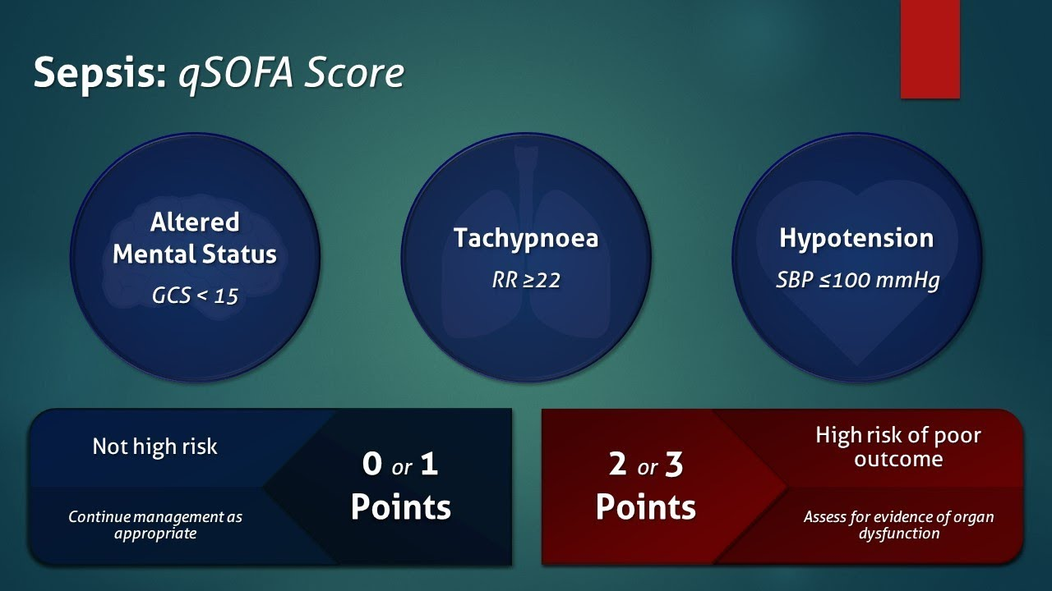
qSOFA SCORE

Slide 24
NEWS SCORING SYSTME

Slide 25
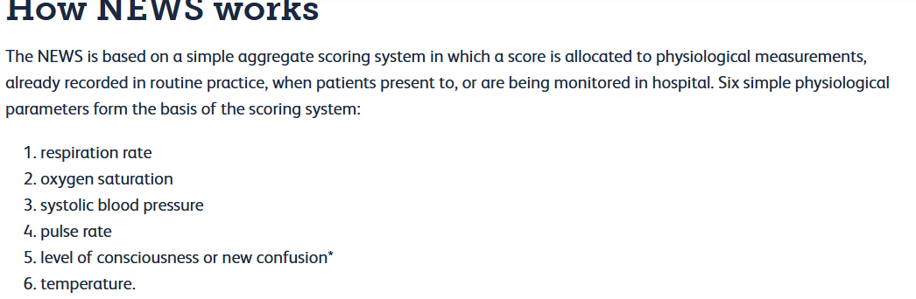
NEWS 2 CRITERIA
Notes:
Key Differences: Updated from NEWS (2012) to include specific management for patients requiring oxygen saturation (SpO2) targets of 88–92% (e.g., COPD patients) and to better assess delirium or new confusion (AVPU score).

Slide 26
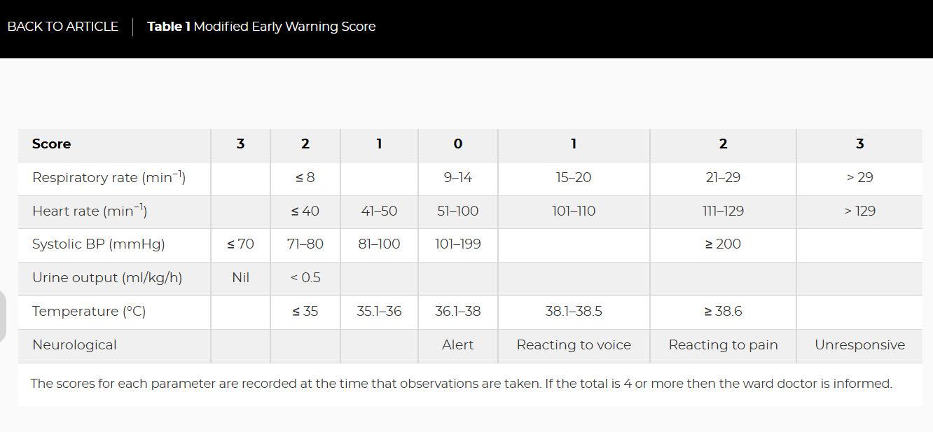
MODIFIED MEWS SCORE

Slide 27
MEWS SCORE
Notes:
Difference from NEWS/NEWS2: MEWS typically does not include oxygen saturation (SPO2 %) as a core parameter and does not differentiate between patients who need oxygen and those who do not

Slide 28
Score | Parameters Measured | Criteria / Components | Positive Score | Main Purpose | Key Features
SIRS (Systemic Inflammatory Response Syndrome) | 4 parameters | • HR > 90 bpm • RR > 20/min • Temp < 36°C or > 38°C • WBC < 4,000 or > 12,000/mm³ | ≥ 2 / 4 | Detect systemic inflammation | Very sensitive, not specific for sepsis
qSOFA (Quick SOFA) | 3 parameters | • SBP ≤ 100 mmHg • RR ≥ 22/min • GCS < 15 | ≥ 2 / 3 | Identify high-risk sepsis patients | Quick bedside tool, more specific
EWS (Early Warning Score) | 5 parameters | • SBP • Pulse rate • RR • Temperature • AVPU (Alert, Voice, Pain, Unresponsive) | No fixed universal cutoff | Detect early clinical deterioration | Simple bedside monitoring tool
NEWS (National Early Warning Score) | 7 parameters | • RR • Oxygen saturation • Supplemental O₂ use • Temperature • SBP • Pulse rate • Consciousness level | ≥ 5 (Red flag) | Detect acute illness severity | Standardized, widely used, score 0–20
MEWS (Modified EWS) | 5 parameters | • SBP • HR • RR • Temperature • Mental status | Varies (trend-based) | Identify deterioration (esp. surgical patients) | Considers deviation from baseline; may include urine output
Notes:
Sensitivity and Specificity
Sensitivity is the proportion of true positives correctly identified by a tes
Specificity is the proportion of true negatives correctly identified. It answers: “
PPV is the probability that a person with a positive test result actually has the disease.
NPV is the probability that a person with a negative test result truly does not have the disease

Slide 29
A COMPARATIVE STUDY BETWEEN SIRS, QSOFA, NEWS AND MEWS SCORE AS PREDICTORS FOR INHOSPITAL MORTALITY OF PATIENTS GETTING ADMITTED TO ICU OF A TERTIARY CARE TEACHING HOSPITAL
Score | Sensitivity | Specificity | PPV / NPV | AUROC (95% CI) | Key Takeaway
SIRS ≥2 | 77.78% | 23.88% | Low PPV, high NPV | 0.49 (0.37–0.61) | Very sensitive, poor specificity; weak prognostic accuracy
qSOFA ≥2 | 36.02% | 73.61% | Higher PPV, lower NPV | 0.56 (0.46–0.66) | Specific but insensitive; misses many cases
NEWS ≥5 | 77.78% | 41.79% | Balanced PPV/NPV | 0.61 (0.52–0.71) | Sensitive, moderate specificity; better than SIRS but still limited
MEWS ≥5 | 76.36% | 63.91% | Best balance | 0.76 (0.68–0.84) | Highest overall prognostic accuracy

Slide 30
(Majmundar et al., 2023)
Interpretation
MEWS ≥5: Best overall predictor of ICU mortality (highest AUROC, balanced sensitivity/specificity).
SIRS: Overly sensitive, poor specificity → not reliable for mortality prediction.
qSOFA: High specificity but very low sensitivity → good for ruling in high-risk patients, but misses many.
NEWS: Similar sensitivity to SIRS, slightly better specificity, but still inferior to MEWS.
No single score achieves both high sensitivity and specificity → bedside tools should complement, not replace, clinical judgment.
Notes:
Sensitivity and Specificity
Sensitivity is the proportion of true positives correctly identified by a tes
Specificity is the proportion of true negatives correctly identified. It answers: “
PPV is the probability that a person with a positive test result actually has the disease.
NPV is the probability that a person with a negative test result truly does not have the disease

Slide 31
CONT…
Clinical Pearl
MEWS is most useful for prognostic accuracy in ICU mortality.
qSOFA is best for identifying patients at high risk of poor outcomes (specificity).
SIRS/NEWS remain sensitive screening tools but lack discriminative power

Slide 32
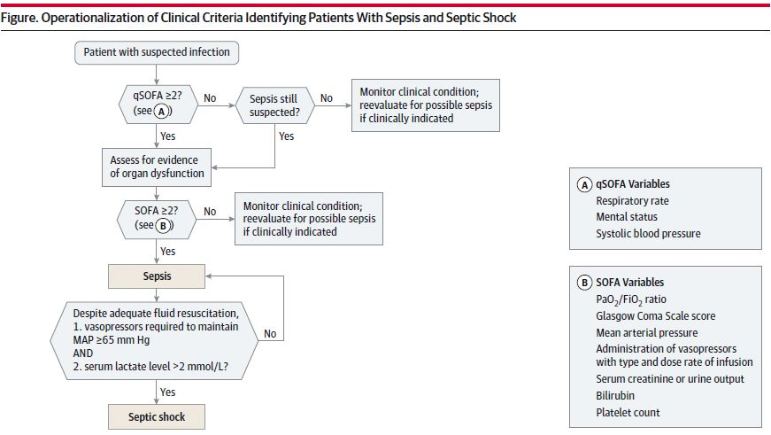

Slide 33
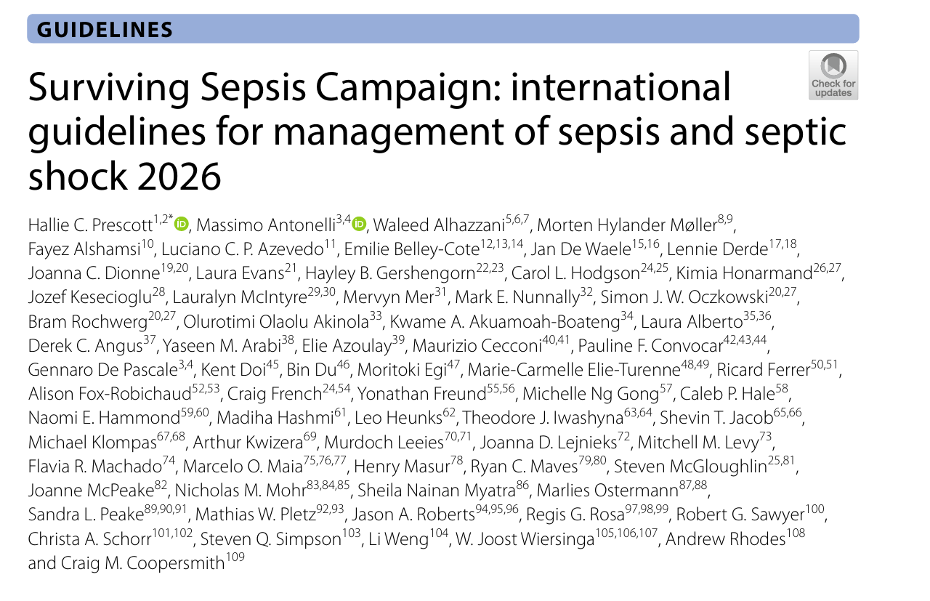
RECOMMENDATIONS FROM THE SURVIVING SEPSIS CAMPAIGN-2026

Slide 34
APPROACH TO A PATIENT WITH SEPTICAEMIA
Conditional recommendation: Hospitals should consider implementing “code sepsis”/“sepsis huddle” protocols—rapid multidisciplinary bedside coordination—to expedite diagnosis and treatment of Sepsis despite low-certainty evidence.
For acutely ill patients in hospital, it is strongly “recommend” using NEWS, NEW2, MEWS, or SIRS over qSOFA as a single tool to screen for sepsis (strong recommendation, moderate certainty evidence)
Good practice: Sepsis remains a clinical diagnosis (not based on a single biomarker/test), and there is insufficient evidence to recommend novel rapid host-response diagnostics.

Slide 35
CONT…
strong recommendation: in suspected or confirmed sepsis or septic shock, obtain blood cultures asap—ideally before starting antimicrobials
conditional recommendation: in suspected or confirmed sepsis or septic shock, measure blood lactate .
emergency care: sepsis and septic shock require immediate treatment, including ≥30 ml/kg iv crystalloids within 3 h, with individualized dosing and frequent reassessment to avoid under-/over-resuscitation

Slide 36
CONT….
Conditional recommendation: In sepsis-induced hypotension due to Sepsis, give initial IV crystalloid bolus, then add vasopressors if hypotension persists; in unstable septic shock, start vasopressors concurrently with fluids based on clinical signs
Conditional recommendation: In septic shock due to Sepsis, start vasopressors via peripheral IV to rapidly restore MAP rather than delaying for central access (very low-certainty evidence).

Slide 37
INFECTION TIMING OF ANTIBIOTIC INITIATION IN HOSPITAL
antibiotics (≤1 h):In Sepsis with septic shock or likely sepsis, administer antimicrobials as soon as possible (ideally within 1 hour).
Possible sepsis (no shock): Perform rapid assessment; if infection remains suspected, start antimicrobials within 3 hours.
Low infection likelihood: If no shock and low suspicion, defer antibiotics with close monitoring and reassessment.
For adults with sepsis or septic shock who require ICU admission, we “suggest” admitting the patients to the ICU within 6 h (conditional recommendation, low certainty evidence)

Slide 38
CONT…
In sepsis/septic shock, empiric MDR coverage is suggested only for high-risk patients (e.g., prior colonization/infection, prolonged broad-spectrum antibiotics, high-prevalence units), but not recommended in low-risk patients (conditional, very low certainty).
In sepsis/septic shock, omit anaerobic coverage if no risk factors, but include it when anaerobic infection is suspected (e.g., intra-abdominal, necrotizing soft tissue, gynecologic, head/neck infections, CNS abscess/empyema) (conditional, very low certainty).
In sepsis/septic shock, use prolonged (extended/continuous) beta-lactam infusions after a loading dose rather than intermittent bolus dosing (strong recommendation, moderate certainty).

Slide 39
CONT…
In sepsis/septic shock with adequate source control, shorter antibiotic courses are suggested over longer durations .
In sepsis/septic shock with adequate source control and unclear duration, procalcitonin-guided plus clinical assessment is suggested over clinical assessment alone to guide antibiotic discontinuation

Slide 40
HEMODYNAMIC MANAGEMENT
First-line fluids: Use crystalloids for resuscitation in sepsis/septic shock; prefer balanced crystalloids over 0.9% saline, except use 0.9% saline in traumatic brain injury (strong/conditional, moderate certainty).
Adjunct fluids: Crystalloids alone are preferred over routine addition of albumin; albumin may be considered only after large crystalloid volumes or in cirrhosis, and avoided in TBI (conditional, moderate certainty).
Avoided fluids: Do not use starches (strong recommendation, high certainty) and avoid gelatin for resuscitation (conditional, moderate certainty).

Slide 41
IV VASOPRESSOR
First-line vasopressor; Use norepinephrine as the first-line vasopressor in septic shock (strong recommendation) over dopamine, epinephrine, selepressin, vasopressin, and angiotensin II.
Escalation strategy: If MAP remains inadequate, add vasopressin to norepinephrine, and if still refractory, consider adding epinephrine (conditional recommendations). Avoid terlipressin (conditional against use).
Special situation (cardiac dysfunction): Either norepinephrine or epinephrine may be used first-line in septic shock with cardiac dysfunction, with choice guided by clinical profile (e.g., arrhythmia risk).
In refractory septic shock, IV methylene blue has insufficient evidence for recommendation as rescue therapy despite possible BP improvement, with no proven survival benefit and minimal routine use in practice.

Slide 42
IONOTROPES
Inotrope use: In septic shock with cardiac dysfunction and persistent hypoperfusion despite adequate fluids and MAP, use inotropes in addition to vasopressors (e.g., add dobutamine to norepinephrine or use epinephrine alone) (conditional, very low certainty).
Avoid: Levosimendan is suggested against in this setting due to insufficient supporting evidence (conditional, low certainty).

Slide 43
RESPIRATORY SUPPORT
In sepsis, oxygenation assessment is suggested using either pulse oximetry (SpO₂) or arterial blood gas (SaO₂) alongside clinical evaluation (conditional, very low certainty).
ABG is preferred when available as the gold standard, providing broader data (pH, PaCO₂, lactate, bicarbonate) and more accurate oxygenation assessment.
SpO₂/FiO₂ can substitute for PaO₂/FiO₂ but is less reliable in shock, extreme saturations, and in patients with darker skin tones.

Slide 44
NON-INVASIVE
In sepsis with acute hypoxemic respiratory failure (PaO₂/FiO₂ <200 or SpO₂/FiO₂ <235), high-flow nasal cannula (HFNC) is suggested over conventional oxygen therapy and non-invasive ventilation (conditional recommendations, very low to low certainty).
HFNC is also suggested as initial respiratory support over non-invasive positive pressure ventilation.
HFNC is preferred over alternating HFNC with non-invasive ventilation due to insufficient evidence for added benefit.

Slide 45
INVASIVE
In sepsis with ARDS; Use lung-protective ventilation with low tidal volume (6 mL/kg IBW) and limit plateau pressure ≤30 cmH₂O (strong recommendations, high certainty).
Without ARDS: Use tidal volume 6–8 mL/kg IBW rather than very low tidal volumes (4–<6 mL/kg) (conditional, low certainty).
Clinical note: Regularly reassess for development of ARDS as diagnosis is often missed or delayed.

Slide 46
CONT..
In moderate–severe ARDS in sepsis, use higher PEEP (over lower PEEP) and prone positioning >12 hours daily, but avoid incremental PEEP titration strategies (conditional/strong recommendations, moderate certainty).
For neuromuscular blockade, intermittent bolus dosing is suggested over continuous infusion (conditional, moderate certainty).
Veno ECMO
In severe sepsis-related ARDS, Veno-venous ECMO is suggested as rescue therapy when conventional ventilation fails, only in experienced centers with appropriate infrastructure (conditional, low certainty).

Slide 47
ADJUVANT THERAPIES
In septic shock, IV corticosteroids are suggested for patients with ongoing shock despite adequate fluid resuscitation and vasopressors (conditional, low certainty evidence).
In sepsis/septic shock, antipyretic therapy (drug or surface cooling) is suggested against for improving outcomes, except when used for symptom relief, pain control, or other specific indications (conditional, very low certainty).
In sepsis/septic shock, IV immunoglobulins are suggested against for routine use due to lack of clear outcome benefit (conditional, low certainty evidence).
In sepsis/septic shock, IV vitamin C is suggested against for routine use due to insufficient evidence of clinical benefit (conditional, low certainty evidence).

Slide 48
CONT…
In sepsis/septic shock, pharmacologic VTE prophylaxis is recommended unless contraindicated, with low-molecular-weight heparin preferred over unfractionated heparin (strong recommendations, moderate certainty).
Mechanical prophylaxis is not routinely added to pharmacologic prophylaxis; use pharmacologic prophylaxis alone (conditional, moderate certainty).
In sepsis/septic shock (after resolution of hypoperfusion and in absence of special indications), transfuse RBCs only when Hb <7 g/dL and target 7–9 g/dL (restrictive strategy).
In sepsis/septic shock with AKI, avoid initiating renal replacement therapy without a clear indication, but when RRT is required, either continuous or intermittent modalities can be used (conditional recommendations, low–moderate certainty).

Slide 49
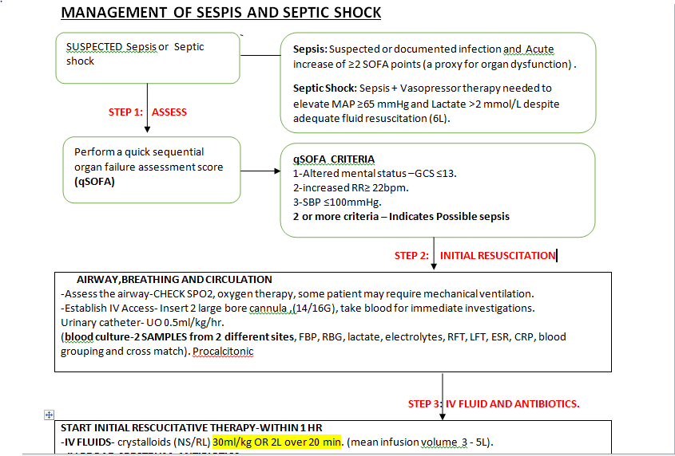
MANAGEMENT SUMMARY

Slide 50
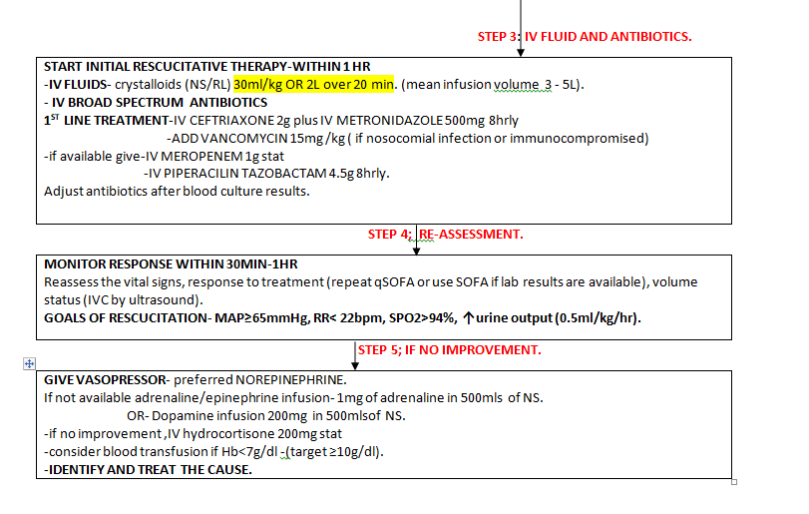

Slide 51
TANZANIA STG
Early resuscitation: Rapid IV crystalloids (0.9% saline or Ringer’s lactate; adults ~2 L, children 20 mL/kg) within the first hour, with reassessment and cautious boluses in heart failure.
Hemodynamic support: If fluid-refractory shock, initiate vasopressors/inotropes (noradrenaline to maintain MAP ≥65 mmHg; dobutamine for low cardiac output) and give hydrocortisone 200 mg IV if indicated.
Early antibiotics (within 1 hour): Start broad-spectrum coverage immediately (ampicillin + cloxacillin + gentamicin), targeting likely polymicrobial sepsis before culture results.
Escalation strategy: If no clinical improvement within 24 hours, escalate to broader agents (ceftriaxone-based regimens or piperacillin-tazobactam combinations with gentamicin; consider meropenem or vancomycin in severe/tertiary cases---- gram-v and gram+ve ).
Adjunct and targeted therapy: Add metronidazole/clindamycin for anaerobes; consider antifungals (fluconazole) in high-risk patients and reserve colistin/linezolid for multidrug-resistant organisms based on culture results VRE $CRB

Slide 52
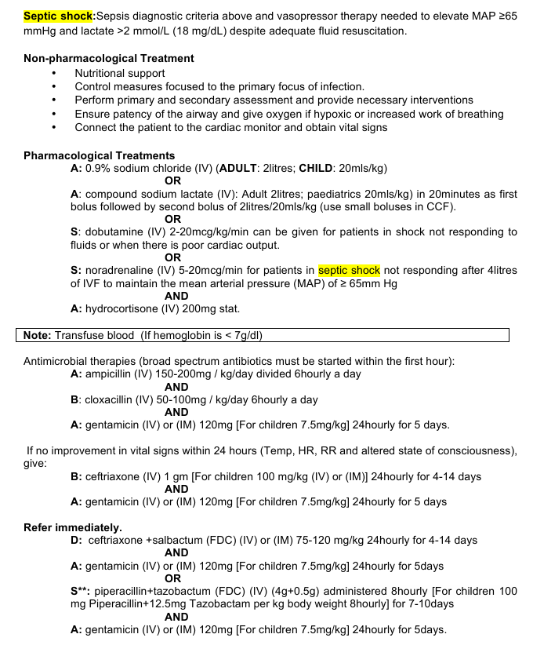
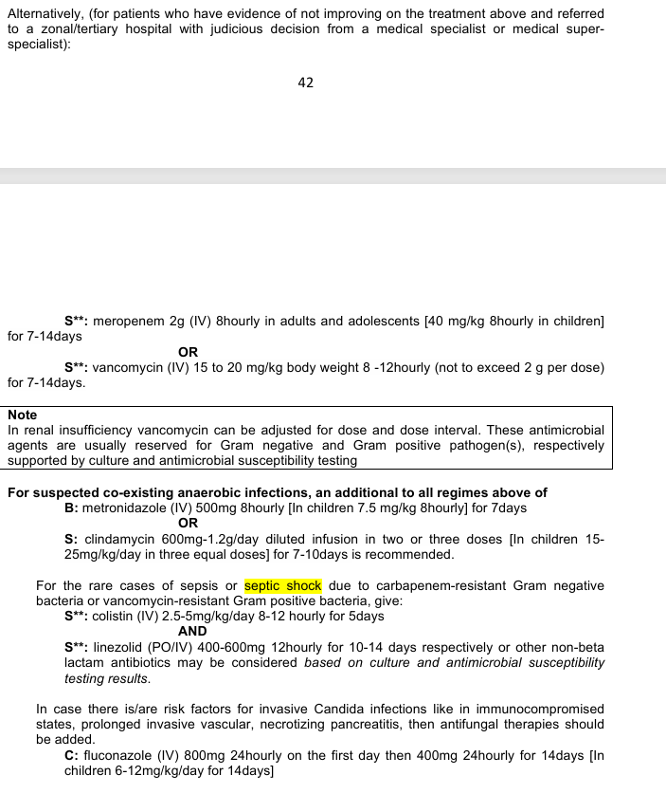

Slide 53
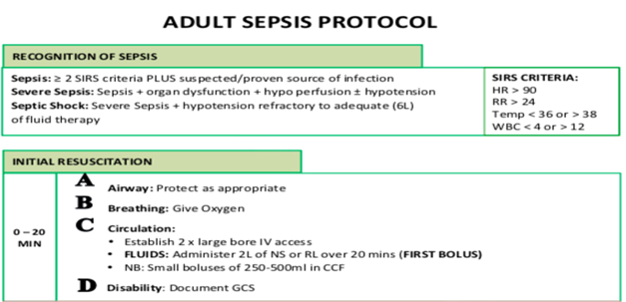
MNH ADULT SEPSIS PROTOCOL

Slide 54
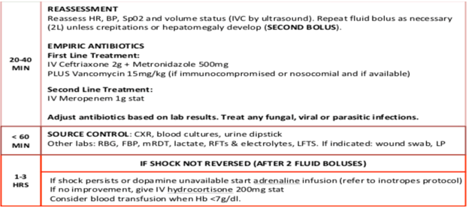

Slide 55
COMPLICATIONS
Acute respiratory distress
Acute kidney injury
Acute liver failure
DIC
Myocardial dysfunction
Endocarditis
Meningitis
Osteomyelitis

Slide 56
WHAT IS NEW
SSC 2026 shifts sepsis management from rigid early “bundle-driven protocol care” (2016) to a more individualized, physiology-guided, antimicrobial-stewardship–focused and ICU-wide organ support approach.

Slide 57
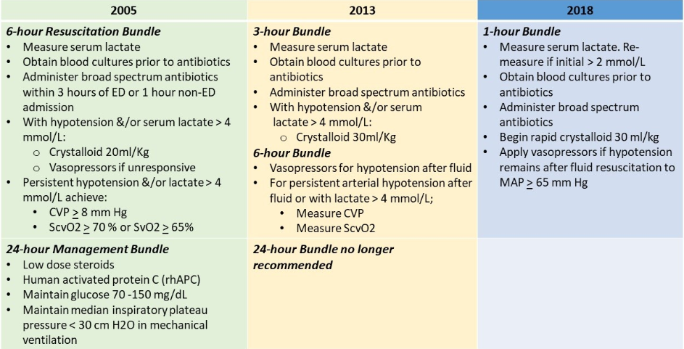
SSC 2026 shifts sepsis management from rigid early “bundle-driven protocol care” (2016) to a more individualized, physiology-guided, antimicrobial-stewardship–focused and ICU-wide organ support approach.

Slide 58
WHAT IS NEW
Surviving Sepsis Campaign: 2026 vs 2016 – Key Updates
Fluid Strategy
  2016: Fixed 30 mL/kg crystalloids
  2026: Individualised, dynamic fluid responsiveness; avoid overload
Antibiotics
  2016: All sepsis → antibiotics within 1 hour
  2026: Immediate in septic shock; risk-based timing in non-shock + stronger de-escalation

Slide 59
WHAT IS NEW
. Hemodynamic Support
  2016: Norepinephrine + fluids protocol-driven
  2026: Earlier vasopressors, balanced crystalloids, physiology-guided resuscitation
Diagnostics & Monitoring
  2016: Lactate + qSOFA emphasis
  2026: Serial lactate, NEWS/MEWS preferred, multimodal clinical assessment
ICU Bundle Expansion
  2016: Core sepsis bundle only
  2026: Full organ support strategy (ARDS care, nutrition, glycaemic control, VTE prophylaxis, stewardship, goals of care)

Slide 60
REFERENCES
2030 global agenda for sepsis: Making the next success story in global health. (n.d.).
de Oliveira, A. M., & de Castro, C. P. (2025). Perspectives in clinical microbiology for combating multi-drug resistant bacterial infections. In Frontiers in Cellular and Infection Microbiology (Vol. 15). Frontiers Media SA. https://doi.org/10.3389/fcimb.2025.1695284
Holmes, C. L., Anderson, M. T., Mobley, H. L. T., & Bachman, M. A. (2021). Pathogenesis of Gram-Negative Bacteremia. https://doi.org/10.1128/CMR
Levinson, Warren. (2016). Review of medical microbiology and immunology. McGraw-Hill Education.

Slide 61
REFERENCES
Prescott, H. C., Antonelli, M., Alhazzani, W., Møller, M. H., Alshamsi, F., Azevedo, L. C. P., Belley-Cote, E., De Waele, J., Derde, L., Dionne, J. C., Evans, L., Gershengorn, H. B., Hodgson, C. L., Honarmand, K., Kesecioglu, J., McIntyre, L., Mer, M., Nunnally, M. E., Oczkowski, S. J. W., … Coopersmith, C. M. (2026b). Surviving Sepsis Campaign: international guidelines for management of sepsis and septic shock 2026. Intensive Care Medicine. https://doi.org/10.1007/s00134-026-08361-1
Silago, V., Kovacs, D., Msanga, D. R., Seni, J., Matthews, L., Oravcová, K., Zadoks, R. N., Lupindu, A. M., Hoza, A. S., & Mshana, S. E. (2020). Bacteremia in critical care units at Bugando Medical Centre, Mwanza, Tanzania: The role of colonization and contaminated cots and mothers’ hands in cross-transmission of multidrug resistant Gram-negative bacteria. Antimicrobial Resistance and Infection Control, 9(1). https://doi.org/10.1186/s13756-020-00721-w

Slide 62
REFERENCES
slam MM, Nasrin T, Walther BA et al (2019) Prediction of sepsis patients using machine learning approach: a meta analysis. Comput Methods Programs Biomed 170:1–9. (n.d.). Slam MM, Nasrin T, Walther BA et al (2019) Prediction of Sepsis Patients Using Machine Learning Approach: A Meta analysis. Comput Methods Programs Biomed 170:1–9.
Vincent, J.-L., Sakr, Y., Singer, M., Martin-Loeches, I., Machado, F. R., Marshall, J. C., Finfer, S., Pelosi, P., Brazzi, L., Aditianingsih, D., Timsit, J.-F., Du, B., Wittebole, X., Máca, J., Kannan, S., Gorordo-Delsol, L. A., De Waele, J. J., Mehta, Y., Bonten, M. J. M., … Angus, D. C. (2020). Prevalence and Outcomes of Infection Among Patients in Intensive Care Units in 2017. JAMA, 323(15), 1478. https://doi.org/10.1001/jama.2020.2717
(2030 Global Agenda for Sepsis: Making the next Success Story in Global Health, n.d.; “Slam MM, Nasrin T, Walther BA et al (2019) Prediction of Sepsis Patients Using Machine Learning Approach: A Meta analysis. Comput Methods Programs Biomed 170:1–9,” n.d.; de Oliveira & de Castro, 2025; Holmes et al., 2021; Levinson, 2016; Prescott et al., 2026a, 2026b; Silago et al., 2020; Vincent et al., 2020)

Slide 63


